Slide 1
Building 917 Reference Photos
Photos of the Aircrew Facility (building 917)

Slide 2
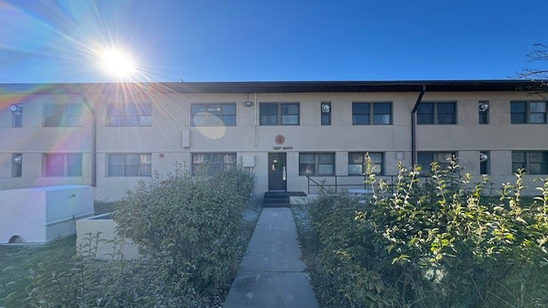
Outside

Slide 3
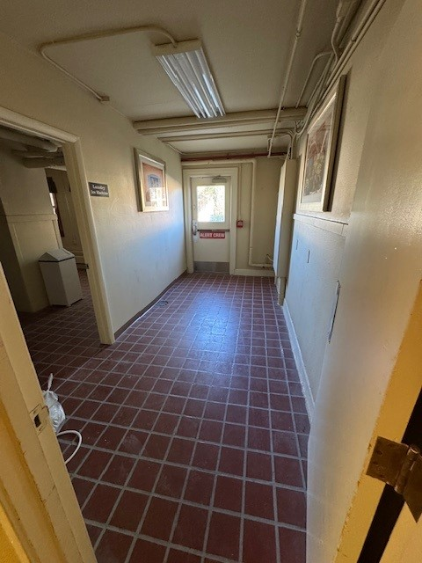
1st Floor; entrance
1st Floor; Entrance

Slide 4
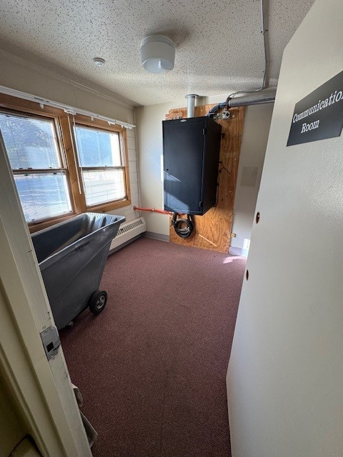
1st Floor; Communication Room
1st Floor; Entrance

Slide 5
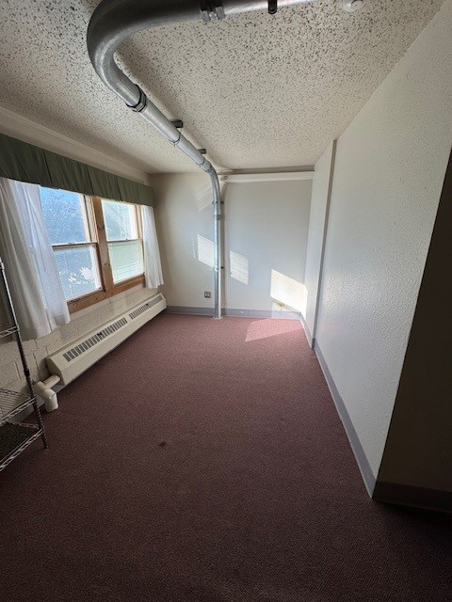
Linen Room
1st Floor; Entrance

Slide 6
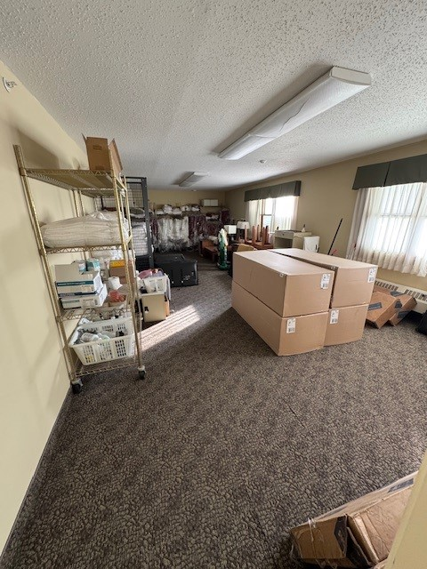
Linen Room
1st Floor; Entrance

Slide 7
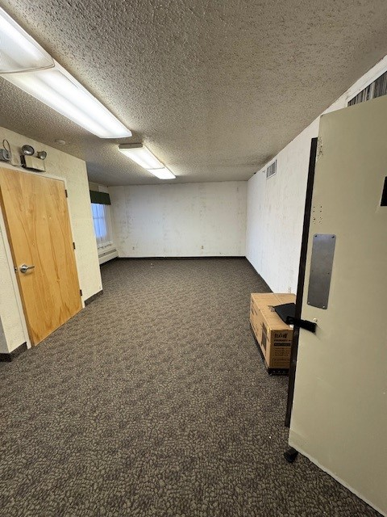
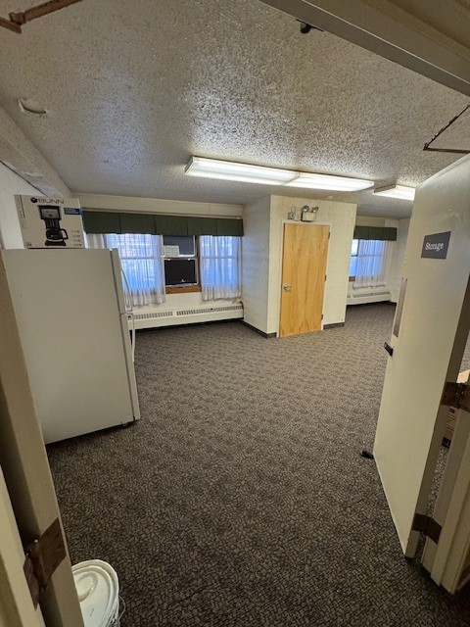
1st Floor; Storage

Slide 8
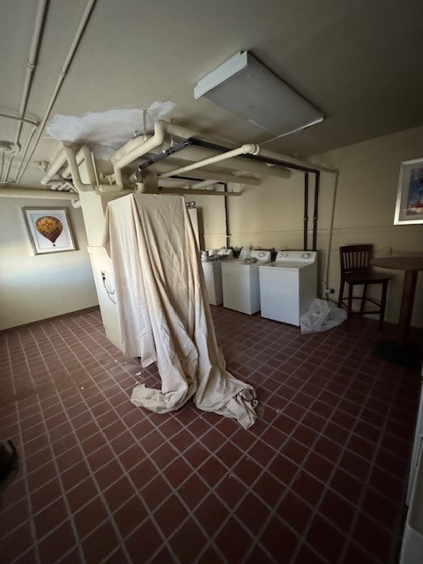
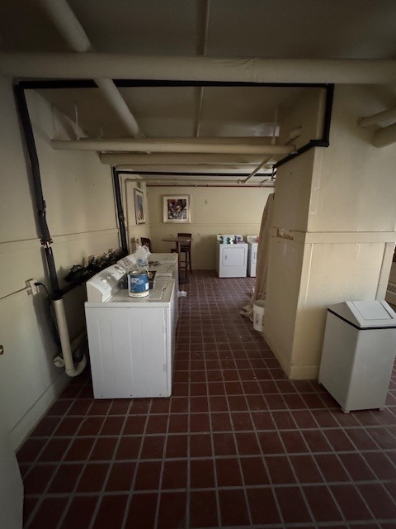
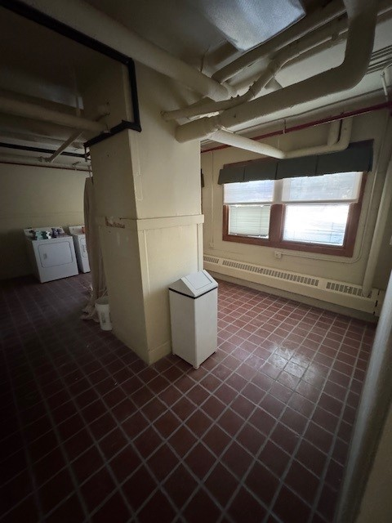
1st Floor; Laundry Room

Slide 9
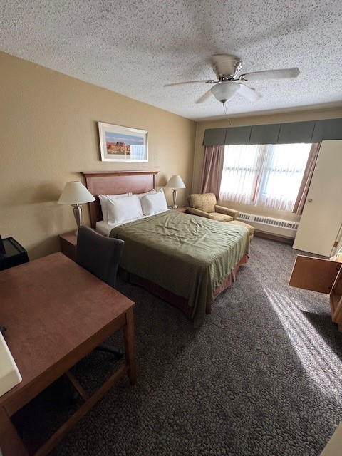
Room (example 1)
1st Floor; Entrance

Slide 10
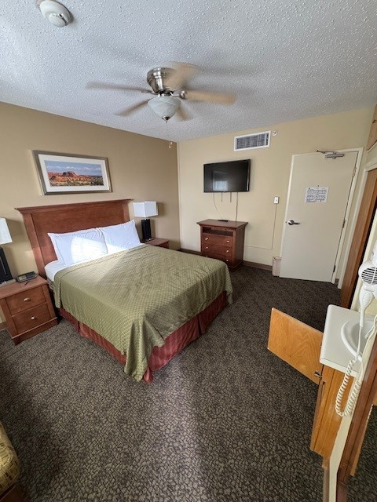
Room (example 2)
1st Floor; Entrance

Slide 11
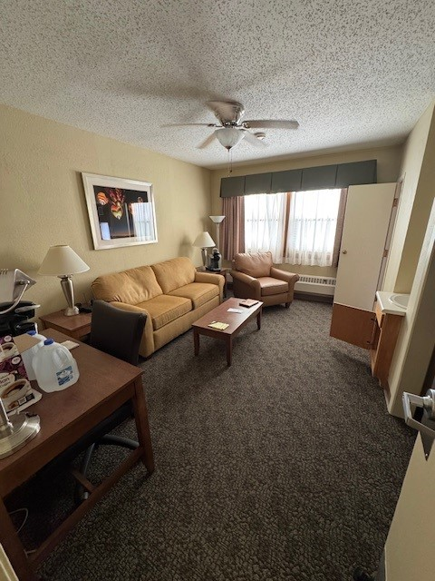
Suite Living Quarter
1st Floor; Entrance

Slide 12
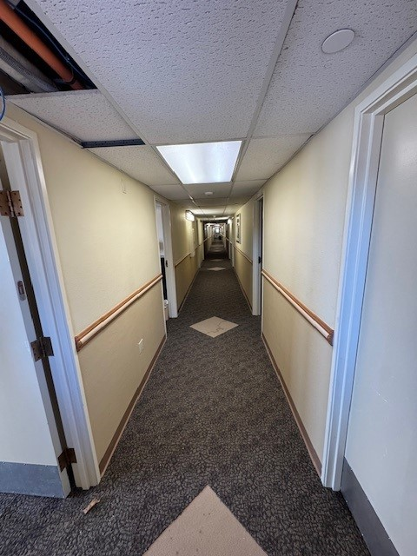
1st Floor;
Hallway
1st Floor; Entrance

Slide 13
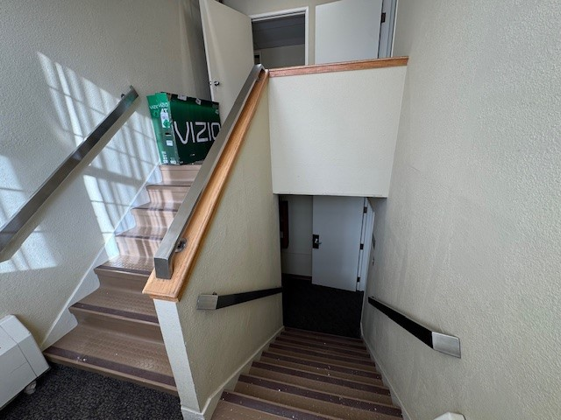
Stairway
1st Floor; Entrance

Slide 14
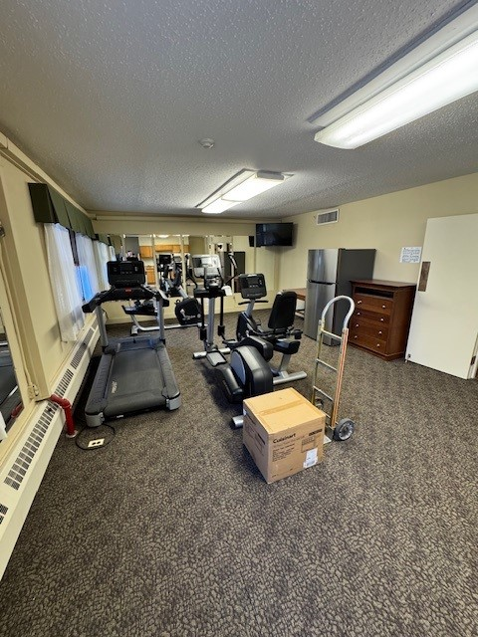
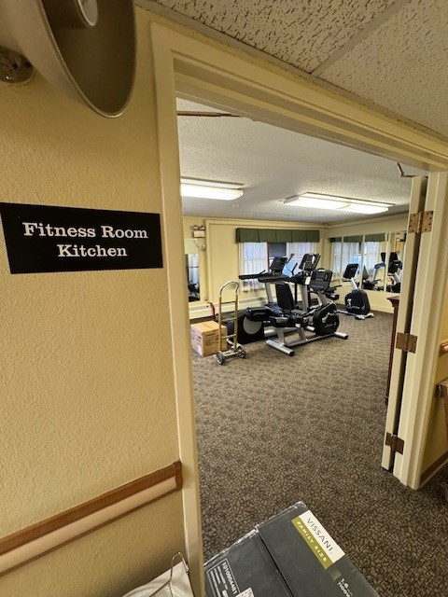
2nd Floor; Gym & Kitchen

